Slide 1
New features for building modern high-performance services

Slide 2
Agenda
HTTP/2 Improvements
HTTP/3 Improvements
Rate Limiting
Output Caching

Slide 3


Slide 4
HTTP/2 Improvements

Slide 5
HTTP/2 - Performance
Refactored HTTP/2 streams management using Channels
https://github.com/dotnet/aspnetcore/pull/40925
Benchmark 1: 110K RPS -> 4,100K RPS
Benchmark 2: 1.2M RPS -> 6.8M RPS
Optimized data frame size negotiation
Faster uploads on high-latency networks

Slide 6
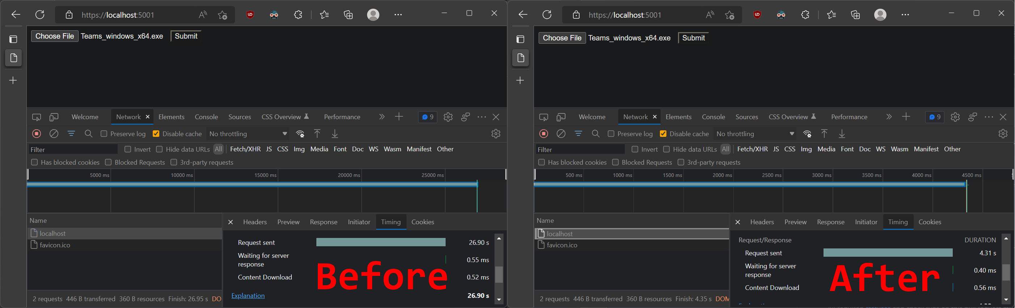
HTTP/2 - Uploads
Updated default negotiated data exchange size
Improved high-latency connection uploads
Example: 26.9s to 4.31s

Slide 7
HTTP/2 - WebSocket
Bi-directional communication
One connection/stream per endpoint in HTTP/1.1
Multiplexing in HTTP/2
Multiple WebSocket endpoints
Single connection per client
No configuration required
Automatic negotiation between browsers and Kestrel

Slide 8
Demo
WebSocket over HTTP/2

Slide 9
HTTP/3 Improvements

Slide 10
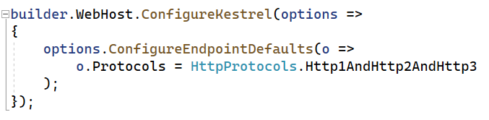
HTTP/3 - Status
Uses QUIC, based on UDP instead of TCP
Support: Chrome, Edge, Firefox, Opera, Safari (opt-in)
Experimental in .NET 6.0
.NET 7.0
Enabled by configuration
Improvements: Reliability, APIs, Correctness, Performance

Slide 11
HTTP/3 - Performance
Memory allocations improvements
Headers encoding performance improvements (QPack)

Slide 12
HTTP/3 - WebTransport
WebSockets over HTTP/1.1
Requires one connection per stream
WebSockets over HTTP/2
Can multiplex multiple data streams on a single connection
One stream can still impact the performance of others
WebTransport over HTTP/3
Multiple independent streams on one connection
Experimental (opt-in)
https://devblogs.microsoft.com/dotnet/experimental-webtransport-over-http-3-support-in-kestrel/

Slide 13
Rate Limiting

Slide 14
Rate Limiting - Goals
Protect the overall health of the system
Limit the number of concurrent requests
E.g., ensure an SLA is met
Prevent users from abusing a resource
API usage limits
Define per-user quotas based on subscription level
Example: GitHub
https://api.github.com/rate_limit
Unauthenticated Requests: 60 requests/hour
Authenticated User Requests: 5000 requests/hour

Slide 15
Rate Limiting - Features
Lease is issued and taken by requests
Fixed time window
Sliding time window
Concurrency limit
Token bucket limit
Partitions to define limits “per” custom values
e.g., User, IP address, company

Slide 16
Demo
Rate Limiting

Slide 17
Output Caching

Slide 18
Output Caching
Driven by configuration
As opposed to Response Caching middleware
Extensible cache stores
Memory (OOB), disk, REDIS, blob storage, …
Cache Stampede and Thundering Herd mitigations with resource locking
Invalidate tagged cache entries
Cache re-validation
eTag, If-Modified-Since
304 – Not Modified

Slide 19
Demo
Output Caching

Slide 20
Conclusion
Free performance
Just upgrade it! ™
Marginal gains
New features
WebSockets
WebTransport
Rate Limiting
Output Caching

Slide 21
Thank You!

Slide 22
Resources
Performance Improvements in .NET 7.0
https://devblogs.microsoft.com/dotnet/performance-improvements-in-aspnet-core-7/
Rate Limiting
https://learn.microsoft.com/en-us/aspnet/core/performance/rate-limit?view=aspnetcore-7.0
Output Caching – Microsoft Build 2022
https://learn.microsoft.com/en-us/events/build-2022/od114-output-caching-in-asp-net-core-7

